Slide 1
Fundamentals
SOFTWARE QUALITY ASSURANCE (SQA)

Slide 2

What you will learn Today
Introduction
Formal ways of writing and managing test cases
Test Design Techniques to optimize our testing efforts

Slide 3
Table of Content
Introduction
Revisit Test-Session Reports from previous day
Overview of Test Cases
Test Design Techniques
Combining the knowledge
Lab Exercise

Slide 4
Revisit Test-Session Reports from previous day

Slide 5
Overview of Test Cases

Slide 6
Exploratory Testing limitations?
Why we need Test Cases
Limitations include
Requires experienced resource with critical thinking
Difficult to trace what tests have been conducted and what is pending
Less time to be familiar with the new application, especially for new testers
Difficult to reproduce the bug
Hard to decide what tools are needed
Difficult to determine the most suitable testing techniques
What else can we do?

Slide 7

Objectives of Scripted Testing
Why we need Test Cases
Guarantee good test coverage
Proof of testing (or not testing)
Better organization and Tracking
Organizable
Repeatable
Trackable

Slide 8
Test Scenarios Vs Test Case ?

Slide 9
Components of a test case
What is a Test Case
Test name. A title that describes the functionality or feature that the test is verifying.
Test ID. Typically a numeric or alphanumeric identifier that QA engineers and testers use to group test cases into test suites.
Objective. Also called the description, this important component describes what the test intends to verify in one to two sentences.
References. Links to user stories, design specifications or requirements that the test is expected to verify.
Prerequisites. Any conditions that are necessary for the tester or QA engineer to perform the test.
Test setup. This component identifies what the test case needs to run correctly, such as app version, operation system, date and time requirements and security specifications.
Test steps. Detailed descriptions of the sequential actions that must be taken to complete the test.
Expected results. An outline of how the system should respond to each test step.

Slide 10
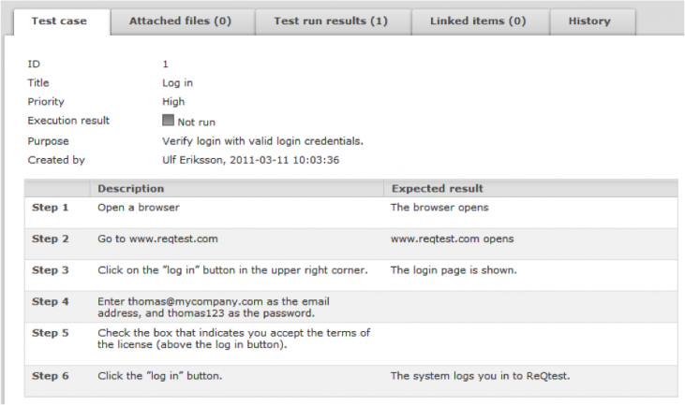
What is a Test Case
Standard Test Case Format

Slide 11
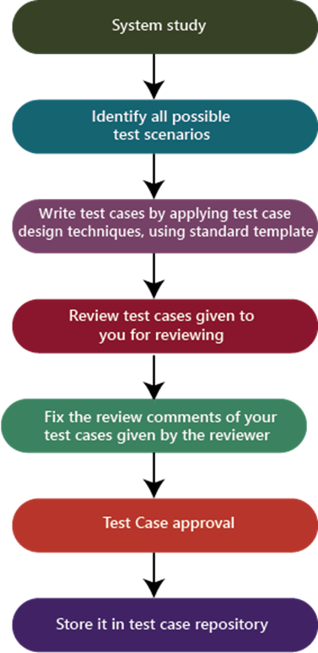
Process to write test cases
Test Case Design and Development

Slide 12
Test Case Design
Test Case Design and Development
Determining in which test areas low-level or high-level test cases are appropriate
Determining the test technique(s) that will enable the necessary coverage to be achieved.
Using test techniques to design test cases and sets of test cases
Identifying necessary test data to support test cases
Designing the test environment and identifying any required infrastructure including tools

Slide 13
Test Case Design
Test Case Design and Development
High Level Test Case
Low Level Test Case
A test case with abstract preconditions, input data, expected results, postconditions, and actions (where applicable).
Advantages :- A tester is not bound to follow the test cases step by step and thus it gives a chance to explore more edge cases. This also increases the chance to find new bugs.
Disadvantages:- Its disadvantage is that its not sure that all scenarios are covered and its difficult for an inexperienced tester to work with these test cases.
A test case with concrete values for preconditions, input data, expected results, postconditions, and a detailed description of actions (where applicable).
Advantages:-Its advantages is that a tester is unlikely to miss bugs and also its easy for an inexperienced tester to work with these test cases as he can easily get the desired results by following steps.
Disadvantages:- It’s a tedious to executes these test cases again and again and tester may not find job challenges.

Slide 14
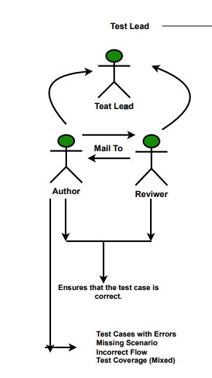
Review Process
Test Case Design and Development
Review Types
Self-review
Peer review
Supervisory Review

Slide 15
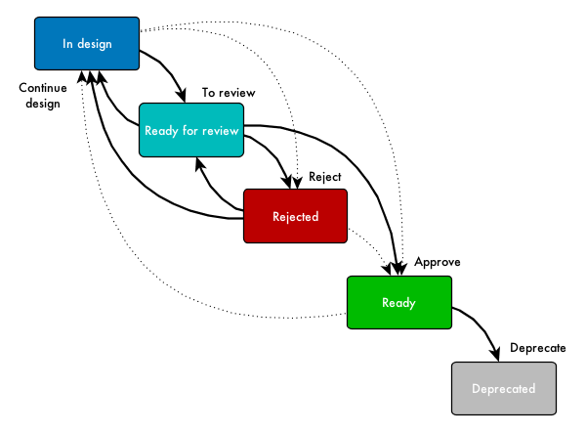
States of a Test Case
Test Case Design and Development

Slide 16
Common Issues in Test Cases
Test Case Design and Development
Incomplete test cases.
Missing negative test cases.
No test data.
Inappropriate/Incorrect test data.
Incorrect Expected behavior.
Grammatical problems.
Spelling errors.
Replication of Test Cases.
Inconsistent tense/voice.
Incomplete results/number of test runs.
Defect information was not recorded in the test case.

Slide 17
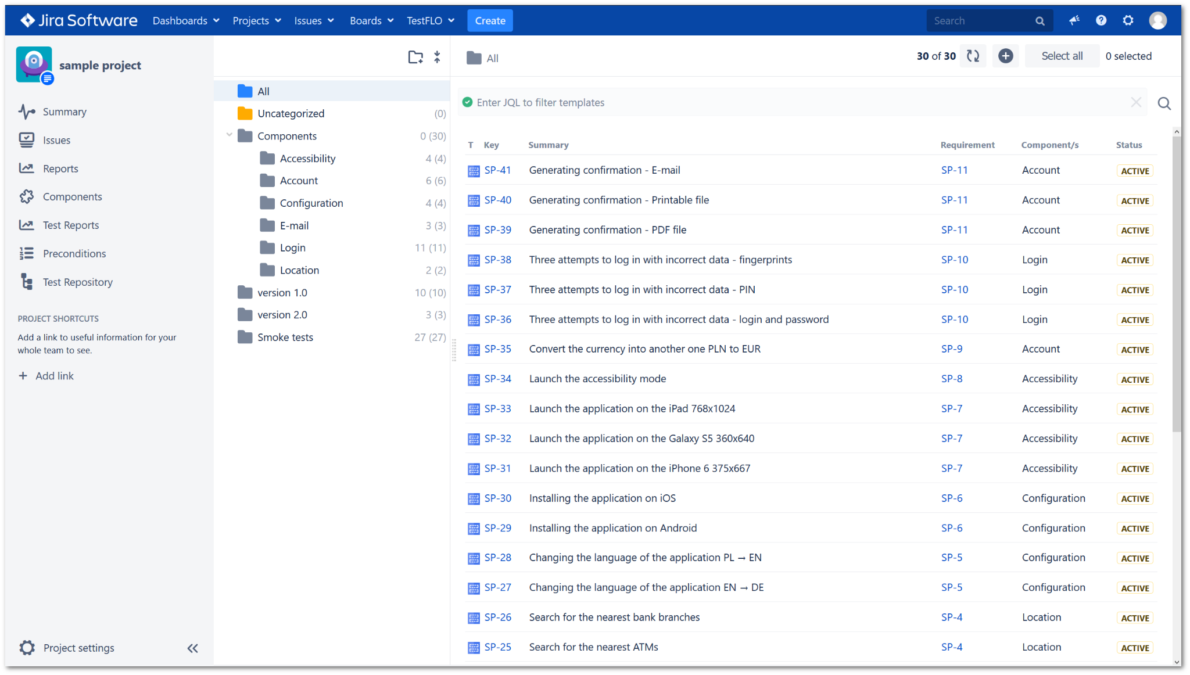
Test Case Design and Development
Sample Test Case Repository

Slide 18
Test Case VS Exploratory Testing
Test Cases vs Exploratory Testing
Test Cases
Exploratory Testing
Pros:
Explicit documented tests
Better Guarantee of Coverage
Easy to trace back to requirements
It’s automatable
Medium and Junior QA can test
Written directly from requirements
Cons:
Not adoptable i.e. can’t deviate from steps
Require documentation and maintenance
Pros:
More adoptable: Tester determines actual test steps
Learning and testing at the same time
Less test prep and documentation
Cons:
Coverage depends on tester’s skill to explore and learn
It’s not automatable
Difficult to trace back to requirements

Slide 19
Why Choose? Test case based testing and Exploratory testing are both excellent techniques for reducing the number of defects found in production. Together they serve as two great complementary techniques that build on each other. Ideally, we would like to do both.
Test Cases vs Exploratory Testing

Slide 20
Exercise
Functional Testing
Write test cases for Whatsapp status feature

Slide 21
Test Design Techniques

Slide 22
Are our tests optimized?
Improve Tests with Test Techniques
Have we identified all unique possibilities?
Have we covered all flows in minimum number of test cases?
Do we have any redundancy in our test cases?
Can we identify what we have not tested?

Slide 23
Test Techniques
Improve Tests with Test Techniques
Help in identifying test conditions, test cases, and test data.
Different design techniques exist to cover different aspects of test coverage
Each has their own strengths, weaknesses and minimum test coverage criteria
Use of test techniques can range from very informal to very formal. Depends on
Context of Testing
Maturity of Test case and Development process
Time constraint
Safety or regulatory requirements
Knowledge and skills of people
Software Development life cycle
Classification of Test Techniques
Black-box test techniques
White-box test techniques
Experience based

Slide 24
Black-box Test Techniques
Black-box Test Techniques
Techniques are based on an analysis of the appropriate test basis, e.g.
requirements
specifications
use cases
user stories
Applicable to functional and non-functional testing
Concentrates on inputs and outputs of the test objects without looking at internal structure
Test cases may be used to detect gaps between the requirements and the implementation of the requirements, as well as deviations from the requirements
Coverage is measured based on the items tested in the test basis and the technique applied to the test basis

Slide 25
Black-box Test Techniques
Black-box Test Techniques
We will cover
Flow Charts
Equivalence Partitioning (Today)
Boundary Value Analysis (Today)
Decision Table Testing (Next Session)
State Transition Testing (Next Session)
Combinatorial Testing (Next Session)

Slide 26
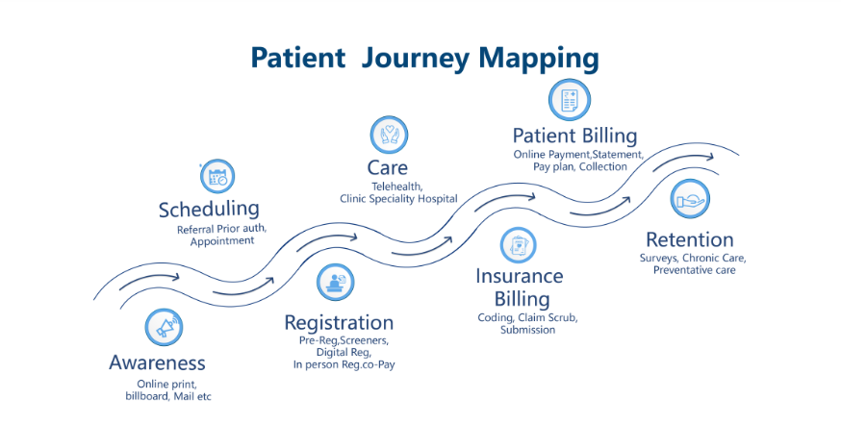
Lets Evaluate a Use Case
Patient Journey

Slide 27
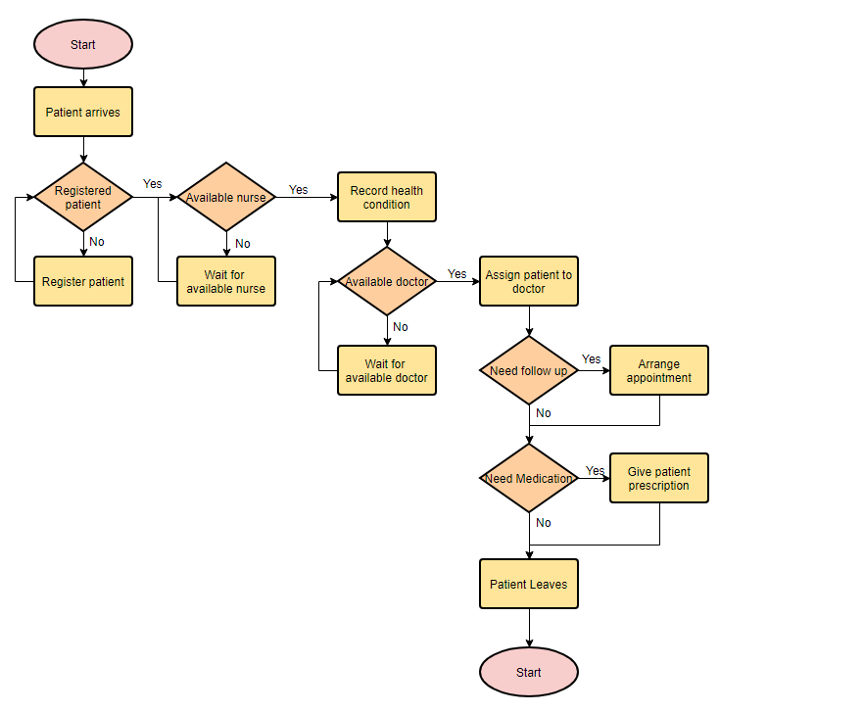
Flow Charts

Slide 28
Equivalence (Class) Partitioning
Equivalence Partitioning
Grouping test conditions into partitions that will be handled the same way
Every value or condition in a partition is treated equivalently
If testing one value from a partition does not result in error then it is less likely to fail for all other values in respective partition
Used for achieving data handling related test coverage and identifying associated bugs
Partitions for a system that takes 1-100 integer values
x < 1
(In valid Partition)
1 <= x <= 100
(Valid Partition)
x > 100
(In valid Partition)

Slide 29
Equivalence (Class) Partitioning (Cont’d…)
Equivalence Partitioning
Coverage in Equivalence partition is determined
Number of tested partitions divided by tested partitions
In example of 1-100 integer values
Data set = {25} -> Coverage = 1/3 = 33.33%
Data set = {3, 25, 97} -> Coverage = 1/3 = 33.33%
Data set = {-10, 25, 110} -> Coverage = 3/3 = 100%
Minimum coverage criteria
One value from each partition
Notice that we have same number of tests but better coverage in second data set

Slide 30
Examples
Equivalence Partitioning
Example 1
Registration for an event opens for a limited time period (1st Jan to 30th Jan)
< 1st Jan
(Early)
1st – 30th
(Valid)
30th Jan >
(Late)
What if 1st to 10th % discount, 11th to 20th 5% discount, and 21st to 30th full price
1st – 10th (15%)
(Valid)
11th – 20th (5%)
(Valid)
21st – 30th (0%)
(Valid)

Slide 31
Examples
Equivalence Partitioning
Example 2
A program displaying name of the day for an input fields of Day, month and year (for 2000 - 2020)
Input partitions:
Valid
Month = {30 Days month, 31 Days month, February}
Day={1-28, 29, 30, 31}
Year={Leap year, Non leap year}
In-Valid
Month = {<1, >12}
Day = {<1, >31}
Year = {<2000, >2020}
Output partitions
Valid
Day = {Monday, Tuesday, Wednesday, Thursday, Friday, Saturday, Sunday}
Invalid
Day = {Invalid date, Date out of range}

Slide 32
Exercise
Equivalence Partitioning
Identify partition and create test cases based on following requirements
A field worker for a furniture company is supposed to fill a form after each job with following fields
Field 1: Job ID
A text field that allows Alphanumeric + “_”.
It is a required field
Has autocomplete feature to show existing job ids as you type
Only job Ids from existing jobs should be allowed
Only one entry against a job ID is allowed
Field 2: Type of job
A drop down with following options
Repair / Installation
It is a required field
Field 3: Product Fixed/Installed
Dropdown with a list of all company products to select from
Required
For Installation job type, then the product list should only show items currently being sold.
For Repair job type, the list should also include old products that are no longer sold

Slide 33
Usage Notes
Equivalence Partitioning
Different types of partitions possible e.g.
Type of possible characters (alphabetic, numeric, special characters)
Data type (integer, float, string, Boolean)
Character length
Partition based on output sets
There are 1-60 questions that need to answered (1 valid set)
80 % of required to pass the exam (now two valid sets – one for pass and one for fail)
Partitions based on past records, usage history or practical conditions, e.g.
most of the users make online orders of 2 to 10 items
Typical min and max temperature is different in month of December than in July

Slide 34
Usage Notes
Equivalence Partitioning
Strengths
Significantly reduce the number of test cases
Effective and efficient technique for maximizing test coverage
One of the commonly used techniques
Efficient in identifying data handling related bugs
Weaknesses
The effectiveness of testing depends upon identified partitions
Their might be partitions that tester is not aware of
e.g. cheat codes integrated in game by developers
e.g. between payment of $1 to $1,000, an other conditions exists that below $500 CCV is not required but for $500 and above it is required
Talking with developers helps a lot to identify all partitions
Combining multiple invalid partitions into one test
e.g. executing only one test by combining invalid username and invalid password.
Does not guarantee if it fails for both
Remember Multiple valid partitions can be tested in one test

Slide 35
Usage Notes
Equivalence Partitioning
Remember:
Do not forget invalid partitions
Each partition must be disjoint set (i.e. no element exists in multiple sets)
Partition exists in many places and multiple forms. Save testing time by finding them
Test each valid and invalid partitions separately
The extent of coverage depends on the requirement criticality and risk-based analysis

Slide 36
Boundary Value Analysis
Boundary Value Analysis
Defining and testing for the boundary values of a partition
Identifies defects related to:
Displacement of boundaries
Omission of boundaries
Occasional extra boundary
Require identification of partitions similar to equivalence partitions and create test cases for boundary values of each partition
For the example of system that takes input of 1-100 integers
Invalid
Valid
Invalid
0 1 2
99 100 101

Slide 37
Boundary Value Analysis (Cont’d…)
Boundary Value Analysis
Boundary value analysis requires following analysis
ON conditions (1 & 100)
OFF conditions (0 & 101)
IN conditions (2 & 99)
School of thoughts
Two value boundary condition – test only ON and OFF conditions
Three value boundary condition – test IN, ON and OFF conditions
Boundary value analysis works only for ordered partitions because we are looking at the edges
Checking boundaries is important because:
Its common for developers to type <100 instead of <=100 : Displacement

Slide 38
Boundary Value Analysis (Cont’d…)
Boundary Value Analysis
Coverage in boundary value analysis is determined
Number of tested distinct boundary values divided by that of total boundary values
In example of 1-100 integer values
Data set = {0,1,2} -> Coverage = 1/2 = 50%
Data set = {99,100,101} -> Coverage = 1/2 = 50%
Data set = {0,1,2,99,100,101} -> Coverage = 2/2 = 100%
Minimum coverage criteria
Test cases with Two/Three values for each boundary value

Slide 39
Examples
Boundary Value Analysis
Example 1
Registration for an event opens for a limited time period (1st Jan to 30th Jan)
Boundaries:
1st Jan & 30th Jan
Test Points
{31st Dec, 1st Jan, 2nd Jan, 29th Jan, 30th Jan, 31st Jan}
What if 1st to 10th % discount, 11th to 20th 5% discount, and 21st to 30th full price
Boundaries:
1st Jan, 10th Jan, 11th Jan, 20th Jan, 21st Jan & 30th Jan
Test Points
{31st Dec, 1st Jan, 2nd Jan, 9th Jan, 10th Jan, 11th Jan, 12th Jan, 19th Jan, 20th Jan, 21st Jan, 22nd Jan, 29th Jan, 30th Jan, 31st Jan}

Slide 40
Exercise
Boundary Value Analysis
Example 2: Price variation for unit purchase to bulk order
Number of units bought | Price per unit
First ten units | $5.00
Next ten units | $4.75
Next ten units | $4.50
More than thirty units | $4.00
Boundaries
0 units, 10 units, 20 units, 30, units
Test Values
0 units at $0, 1 unit at $5, 9 units at $5, 10 units at $5, 11 units at $4.75, 19 units at $4.75, 20 units at $4.75, 21 units at $4.50, 29 units at $4.50, 30 units at $4.50, 31 units at $4.00

Slide 41
Usage Notes
Boundary Value Analysis
Possible boundary values
Edge values on ordered / continuous set
First and last elements in an array/list even if the input is distinct set
Edges values in a sorted list
Edge values of allowed character/digit length
Testing for values of 49,50,51 characters for a field that allows maximum of 3 characters
Edge of allowed list size
Empty list, 1 element list, maximum allowed list, 1 more than maximum allowed list
Checking boundary values based on data structure size

Slide 42
Usage Notes
Boundary Value Analysis
Strengths
Effective in finding bugs as many issues exist on boundary values
One of the commonly used techniques
Efficient in identifying data displacement/omission defects
Weaknesses
The effectiveness of testing depends upon identified boundary values
Emphasizes too much on boundary values and not on rest of functionality

Slide 43
Usage Notes
Boundary Value Analysis
Remember:
BVA works only on ordered partitions
Testing boundary values is very critical because bugs love boundaries
Select the increment/decrement from boundary value smartly (i.e. based on required accuracy)
Boundary values also exist in many forms.
The extent of coverage depends on the requirement criticality and risk-based analysis

Slide 44
Reading Break and Exercise

Slide 45
Exercise
Functional Testing
Evaluate the test cases written for whatsapp status to see where the tests can be optimized

Slide 46

Exercise
Flow Chart
Draw a flowchart for credit card payment
Draw a flowchart for Online order system
Draw a flowchart for Student Admission Process
Draw a flowchart for Hiring Process in a company

Slide 47
Explore some sample test cases
What is a Test Case
High Level Test cases
https://reaction-docs-staging.reactioncommerce.com/docs/testing-matrix
Gherkin test cases
https://github.com/ruandrinho/jekyll/tree/153f24c4e4e00574fce074d8cc261a5f754a0e58/features
collections.feature
https://github.com/ernestio/ernest/blob/master/internal/features/cli/datacenter_list.feature

Slide 48
Exercise
Functional Testing
In a multi-tenant application, the admin needs to fill the following form for each new customer
Database Name:
Purpose: To create separate DB for each customer
Applicable rules on the field:
This field is required
Should be a unique database name
Should be valid with respect to sql database identifiers (Only consider following rules)
First character should be letters [a-zA-Z] only
Other allowed characters are
Letters [a-zA-Z]
Decimal numbers
@, _ $, #
All other special characters are not allowed
Allowed length is 50 characters
Email
Purpose: Customer’s email address to be used as first admin user
Applicable rules
This field is required
Value should be of a valid email format
Allowed length is 50 characters
Password
Purpose: The password for the above user being created as first admin
Applicable rules
This field is required
Should require at-least 1 capital letter and atleast 1 special character
The allowed password length is 6 to 25 characters
Identify EP and BVA for these fields and then identify optimized high-level test cases for these requirements

Slide 49
Reading
What is Software Testing
https://istqb-main-web-prod.s3.amazonaws.com/media/documents/ISTQB_CTAL-TA_Syllabus_v3.1.2.pdf
1.4
https://reaction-docs-staging.reactioncommerce.com/docs/testing-matrix
https://cucumber.io/docs/gherkin/reference/

Slide 50
Reading
What is Software Testing
https://istqb-main-web-prod.s3.amazonaws.com/media/documents/ISTQB-CTFL_Syllabus_2018_v3.1.1.pdf
4.1 & 4.2.1 & 4.2.2
https://istqb-main-web-prod.s3.amazonaws.com/media/documents/ISTQB_CTAL-TA_Syllabus_v3.1.2.pdf
3.2 & 3.2.1 & 3.2.2

Slide 51
Q&A
Instructor Notes

